Slide 1

DATA EXPLORATION AND DATA VISUALIZATION
SETTING THE STAGE
data-action-lab.com

Slide 2
OUTLINE
Data Exploration
Pre-Analysis Data Visualization
Post-Analysis Data Visualization
Visualization Catalogue
Hall-of-Fame / Hall-of-Shame

Slide 3
Some Basic Questions
What system does your data represent – objects, attributes, relationships?
How does it represent this system – i.e. the data model?
Who made this dataset? When? For what purpose?
Assuming a flat file – what do the rows represent? What do the columns represent?
Do you even have enough information (e.g. metadata) to answer these questions? Where can you find more information?

Slide 4
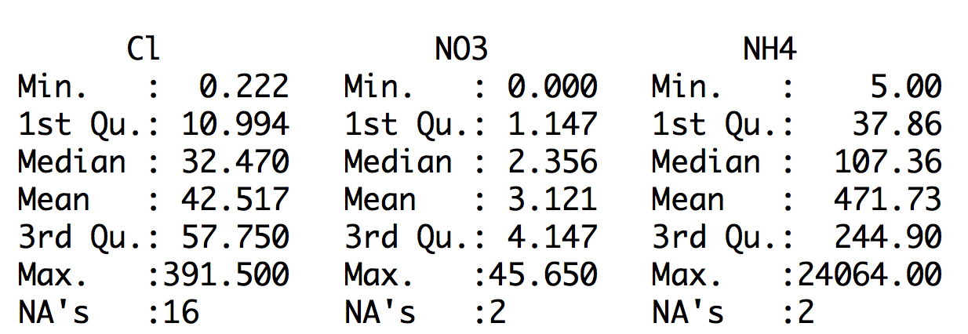
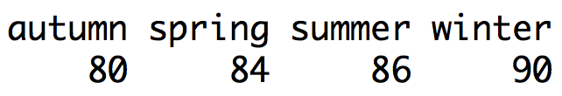
Non-Visualization Based Summaries of Your Dataset

Slide 5
Pre-Analysis Use
Data visualization can be used to set the stage for analysis:
  detecting anomalous entries
  invalid entries, missing values, outliers
  shaping the data transformations
  binning, standardization, Box-Cox transformations, PCA-like transformations
  getting a sense for the data
  data analysis as an art form, exploratory analysis
  identifying hidden data structure
  clustering, associations, patterns informing the next stage of analysis

Slide 6
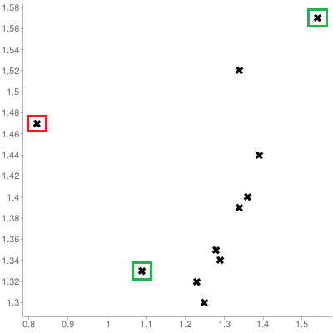
[Personal dataset]
Customers served at counter (per minute)
Customer arrivals at counter (per minute)

Slide 7
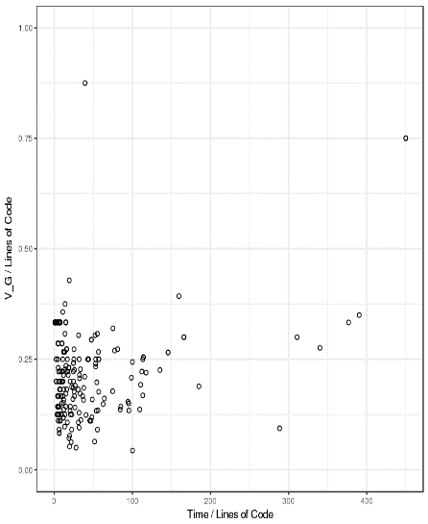
Representing Multivariate Observations
[http://promise.site.uottawa.ca/SERepository/datasets/cm1.arff]
2 variables can be represented by position in the plane. Additional factors can be depicted with:
  size
  color
  value
  texture
  line orientation
  shape
  (motion?)
NASA CM1 Dataset (subset)

Slide 8
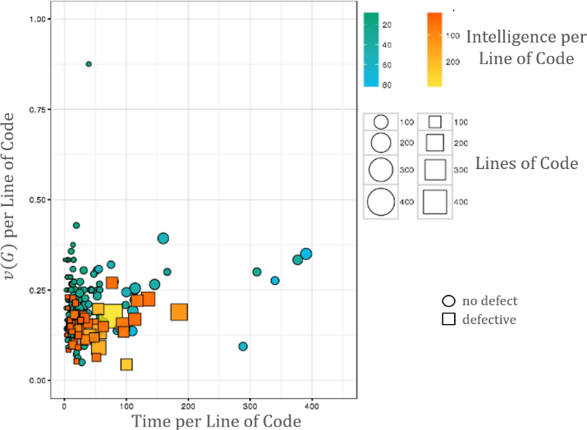
[http://promise.site.uottawa.ca/SERepository/datasets/cm1.arff]
NASA CM1 Dataset (subset)
colour
size
shape
position

Slide 9
Workhorse Data Exploration Visualizations
Line Chart/Rug Chart/Number Line
Histogram
(Boxplots)
Line Graph
Bar Chart
Scatterplot

Slide 10
Fundamental Principles OF ANALYTICAL DESIGN
[E. Tufte, Beautiful Evidence]
Reasoning and communicating our thoughts are intertwined with our lives in a causal and dynamic multivariate Universe.
Symmetry to visual displays of evidence: consumers should be seeking exactly what producers should be providing, namely
  meaningful comparisons
  causal networks and underlying structure
  multivariate links
  integrated and relevant data
  honest documentation
  primary focus on content

Slide 11
Accessibility
A table can be translated to Braille fairly easily, but that’s not always possible for charts.
Describing the features and emerging structures in a visualization is a possible solution… if they can be spotted.
Analysts must produce clear and meaningful visualizations, but they must also describe them and their features in a fashion that allows all to "see" the insights.

Slide 12
Accessibility
[http://dataphys.org/list/]
Analysts need to have “seen” all the insights, which is not necessarily the case (if at all possible).
Data Perception:
  texture-based representations
  text-to-speech
  use of sounds/music
  odor-based or taste-based representations (?!?)

Slide 13
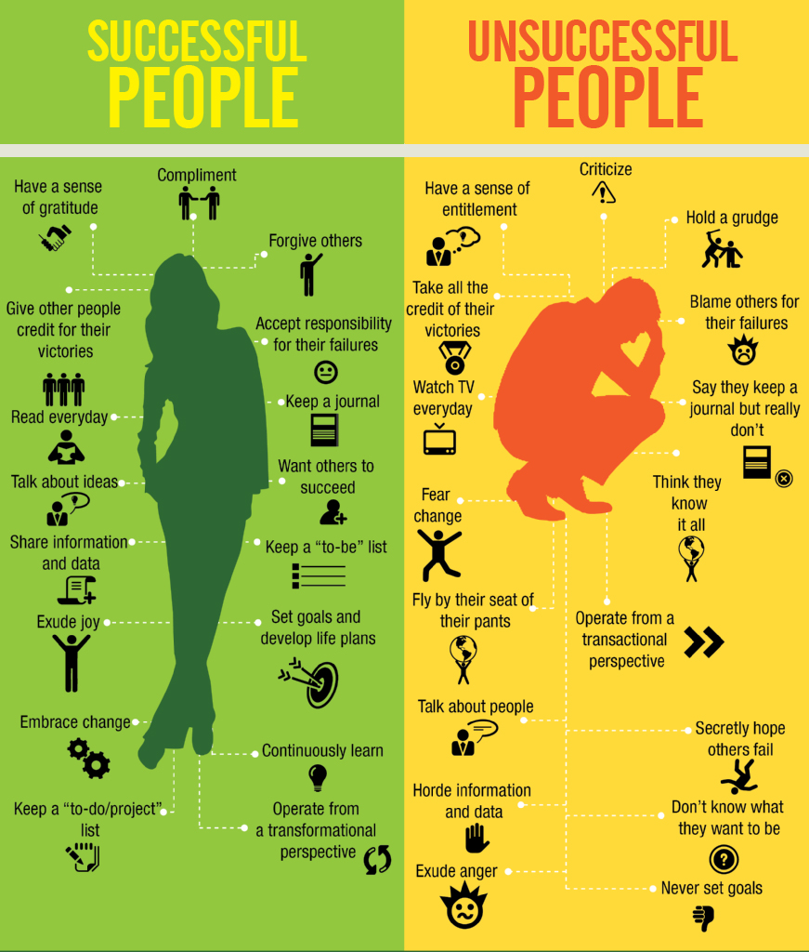
Infographics
[J.P. Blackard]
Created for story-telling purposes (subjective)
Intended for a specific audience
Self-contained and discrete
Graphic design aspect is key
Cannot usually be re-used with other data
Can incorporate unquantifiable information

Slide 14
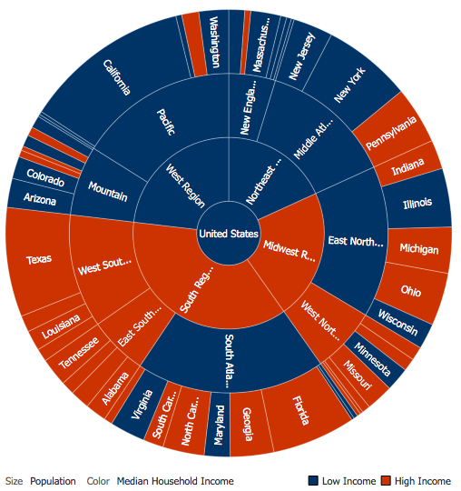
Data Visualization
[Author unknown]
A method, as well as an item (objective)
Typically focuses on the quantifiable
Used to make sense of the data or to make it
accessible (datasets can be massive and unwieldy)
May be generated automatically
The look and feel are less important than the insights conveyed by the data
?

Slide 15
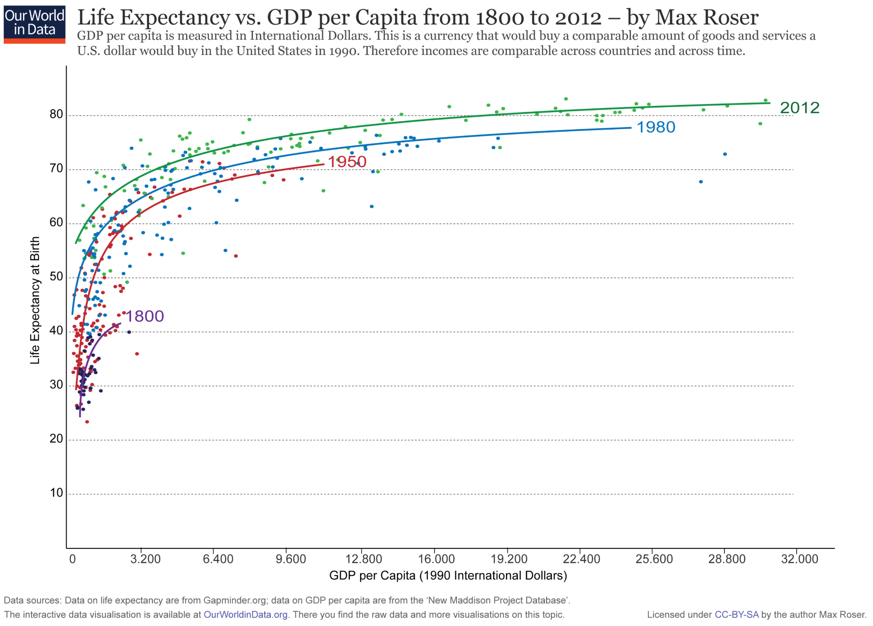
[https://ourworldindata.org/life-expectancy]
This graph displays the correlation between life expectancy and GDP per capita.
Countries with higher GDP have a higher life expectancy, in general.
The relationship seems to follow a logarithmic trend: the unit increase in life expectancy per unit increase in GDP decreases as GDP per capita increases.

Slide 16
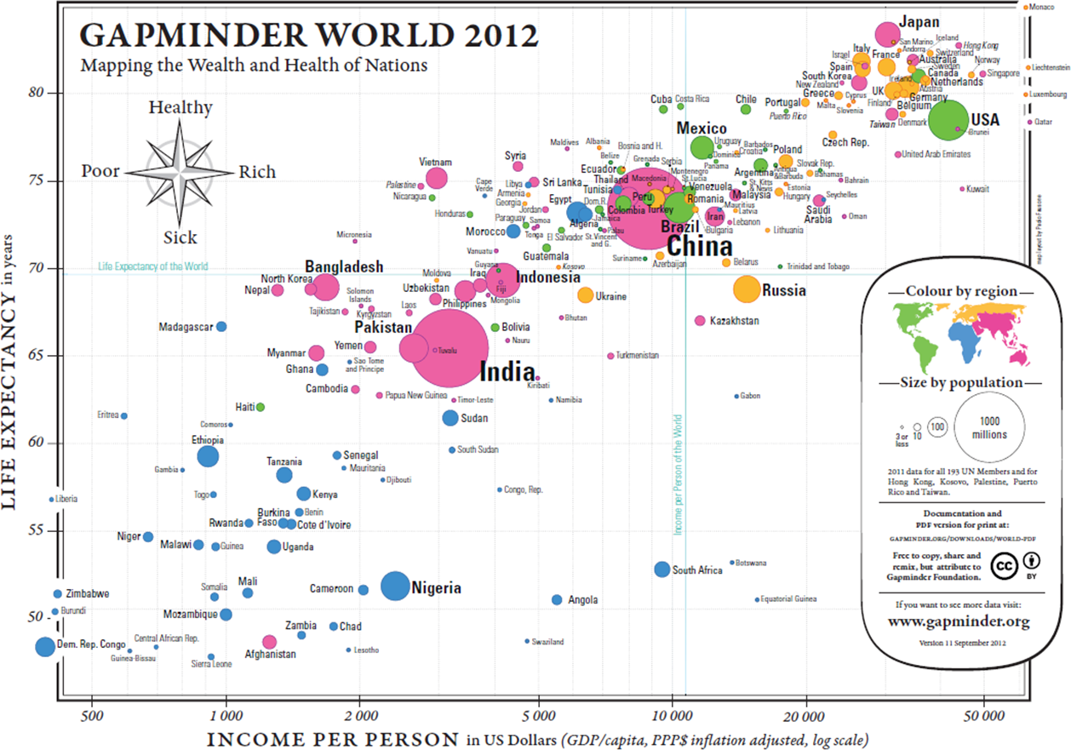
[Gapminder Foundation, https://www.ted.com/talks/hans_rosling_shows_the_best_stats_you_ve_ever_seen]

Slide 17
Presenting Analysis Results
Graphics should be clear and engaging.
Not every pretty picture tells a story, but if a story can't be told with pretty pictures, perhaps it’s time to re-think the story…
Graphical representation techniques appear regularly – it’s too early to tell which ones will stand the test of time.
Don’t be afraid to try something new if it helps convey the message.
Notes:
There is always a danger that if certain types of visualization techniques take over, the kinds of questions that are particularly well-suited to providing data for these techniques will come to dominate the landscape, which will then affect data collection techniques, data availability, future interest, and so forth.

Slide 18
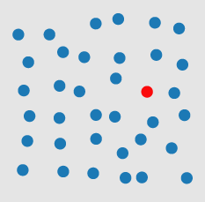
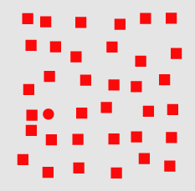
Visual Processing
pre-attentive
Perception is fragmented – eyes are continuously scanning.
Visual thinking seeks patterns
  Pre-attentive processes: fast, instinctive, efficient, multitasking gather information and build patterns:
        features → patterns → objects
  Attentive process: slow, deliberate, focused
  discover features in the patterns:
        objects → patterns → features
attentive
Notes:
Pre-attentive processes

Slide 19
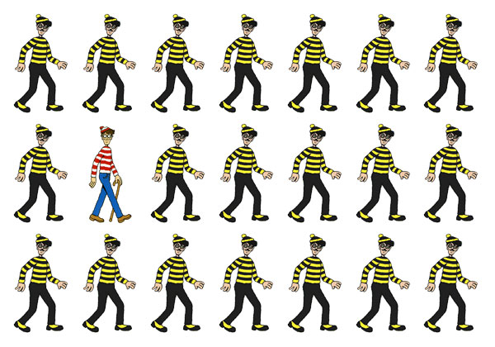
[L. Groeger, A Big Article About Wee Things, ProPublica.com]

Slide 20
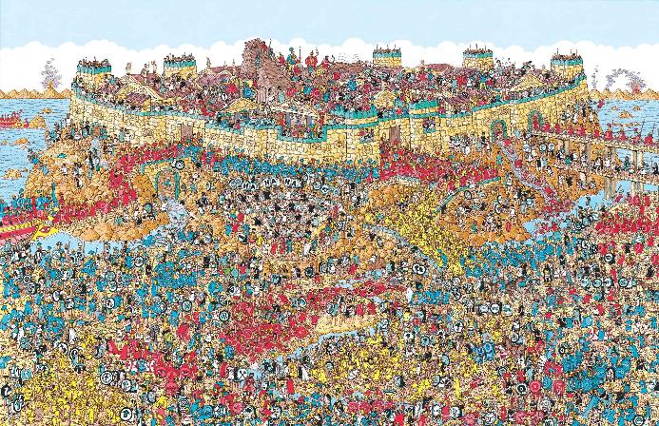
[L. Groeger, A Big Article About Wee Things, ProPublica.com]

Slide 21
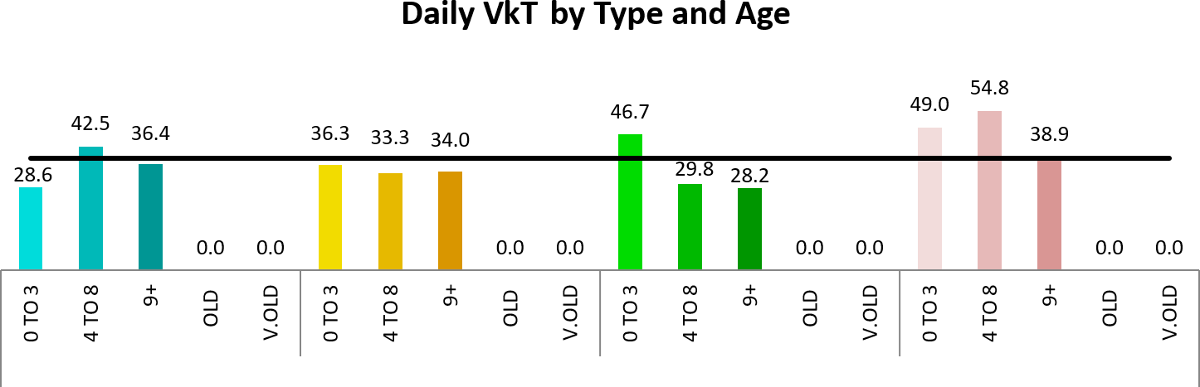
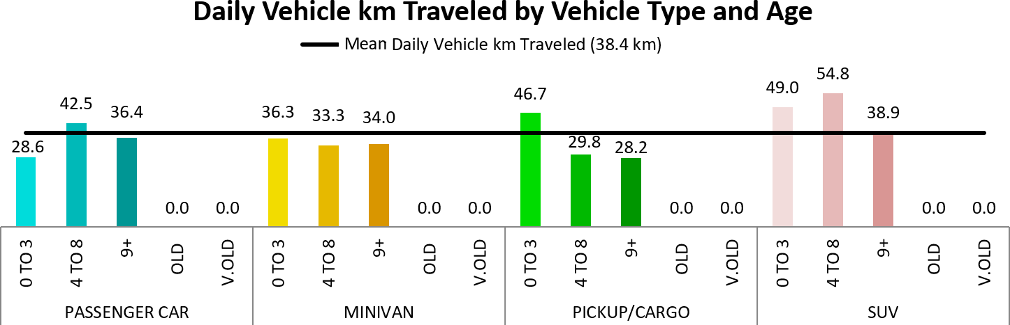
Basic Rules
[http://flowingdata.com/tag/pitfalls]
1. Check the data
outliers, spikes, anomalies
2. Explain encoding
don't assume the reader knows what everything means
3. Label axes
knowing the scale is important

Slide 22

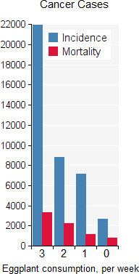
Basic Rules
[http://flowingdata.com/tag/pitfalls]
3.5 radius
4. Include units
eliminate the need for guesswork
5. Keep your geometry in check
circles and 2D shape are sized by area, bar charts by length
6. Include your sources
protect yourself, and let those who want to dig deeper do so
7. Consider your audience
a poster can be wordy, a presentation should be minimalist
?
3.5 area

Slide 23
DISCUSSION
Is the point getting across? Integrated data helps convey the message.
In Semiology of Graphics, Bertin suggests that not all retinal variables are equally effective when it comes to convey or represent information. You may need to experiment to find the optimal choice for the given context.
Adding design elements can enhance our understanding of the data.
How we spot patterns affect what we get out of data presentations.
Data displays are not just about picking a random visualization method. The result varies depending on the structure of the data and the (combinations of) questions.

Slide 24
VISUALIZATION CATALOGUE
Heatmaps/Choropleths
Parallel Coordinates (Spaghetti Plots)
Maps and Distortions
Bubble Charts
Word Clouds and Other Text Visualizations
Network Diagrams
Sparklines
Small Multiples
Interactive Displays
Animated Charts
etc.
Consult the slide deck for examples.

Slide 25
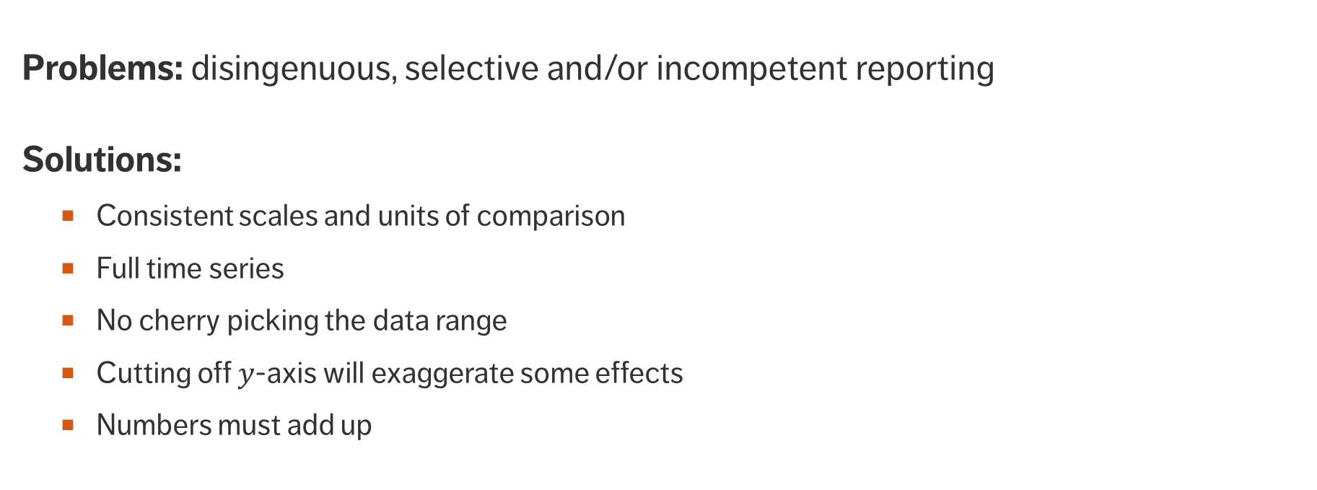
Misleading Charts
Problems: disingenuous, selective and/or incompetent reporting
Solutions:
  Consistent scales and units of comparison
  Full time series
  No cherry picking the data range
  Cutting off -axis will exaggerate some effects
  Numbers must add up

Slide 26
What to Watch For
Some methods yield visually striking, yet misleading, charts.
Be on the lookout for:
  tampering with axes and linear scales
  scaling effects, when representing data points as shapes or volumes
  cherry-picking by omitting certain data points
For low-dimensional datasets, a tabular display may provide as much information and be less likely to mislead.

Slide 27
What to Watch For
Several ways to quantify the misleading level of a chart:
  Lie factor: ratio of size of the effect shown on the graph by the size of the effect in the data
  Data density: number of observations by chart area
  Chartjunk ratio: ratio of area required to convey the data insight by chart area
Typically, the lie factor and chartjunk ratios should be close to 1, while the data density should be “high” (within reason).

Slide 28
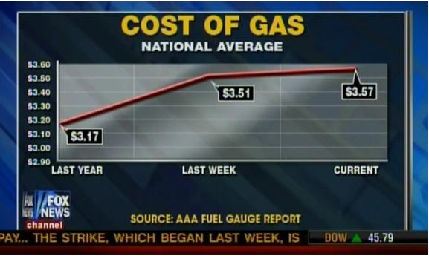
Misleading Charts
[Fox News, February 20, 2012, mediamatters.org, simplystatistics.org, badgraphs.tumblr.com]

Slide 29
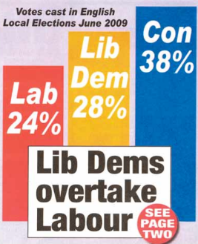
Misleading Charts
[Norwich North Electoral District, mediamatters.org, simplystatistics.org, badgraphs.tumblr.com]

